Slide 1
Local Authority certificates and required approvals

Slide 2
Local authority Documents required for deed of Transfer
Street line certificate
Buillding Line Certificate
Non- vesting certificate
Certificate of ownership
Approved building plans “if there is a building”
Certificate of conformity
Notice of assessment for the current year
Last Payment of tax receipt

Slide 3
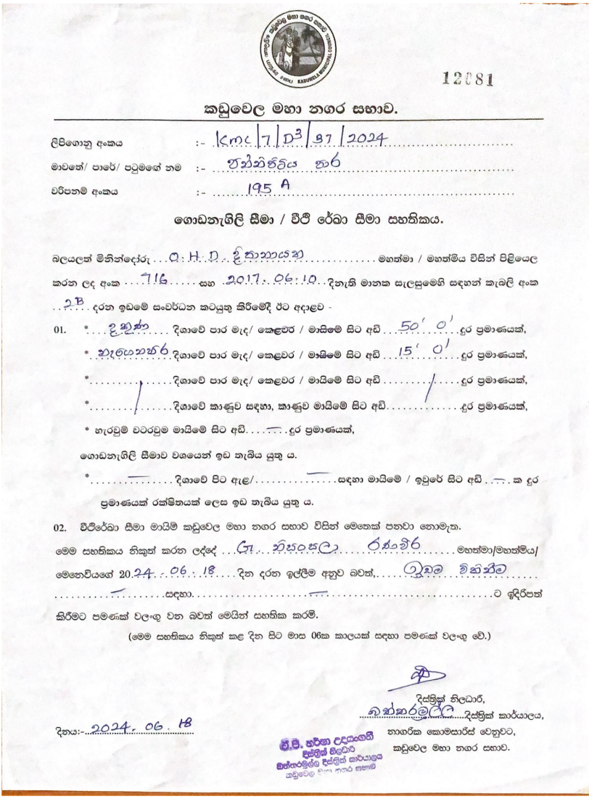
Building line certificate
Ascertains whether any street line approved by the Council passes through the property.
This is done in order to know whether any portion of the land along the road could be taken over by the Council for the widening of the street.
Sections 5, 7 and 19 of the Housing and Town Improvement Ordinance are relevant.
The effect of sections 5 and 7 of the Ordinance is to ensure that no purchaser would buy land between street lines with a view to building upon it and not to render such land sterile and valueless.

Slide 4
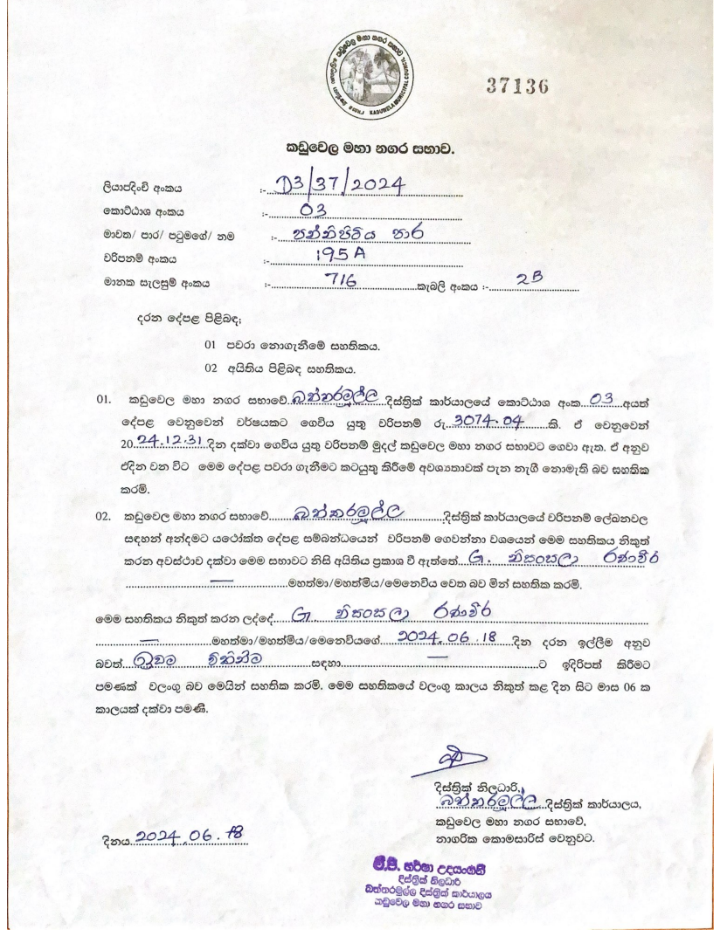
Non vesting certificate
This certificate states what amounts are due to
the council in respect of the property on account
of consolidated rates and who is the person who is
entered on the Assessment register as owner of the
premises; what amounts; are outstanding in respect
of aided drainage and water mains. The certificate
will also state whether the property has or has not
vested in the Council for non-payment of rates and
other dues in respect of the property;

Slide 5
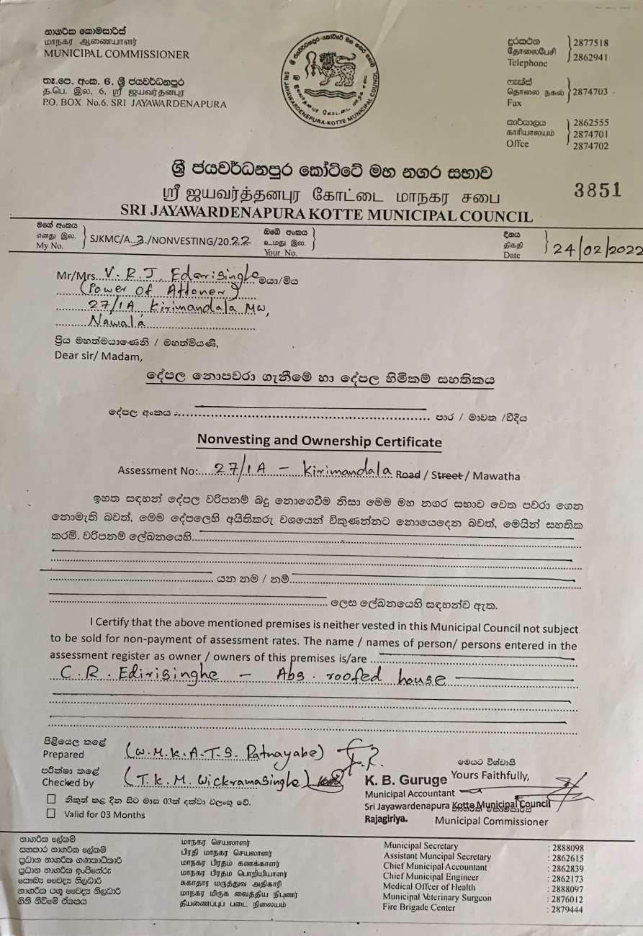
Certificate of ownership
Certificate of Ownership This is an approved and certified certificate that shows the actual owner of the property or land. This document is also very vital in the registration process. It is provided by the Assessment Department of the relevant Municipal Council in the respective District or City.

Slide 6
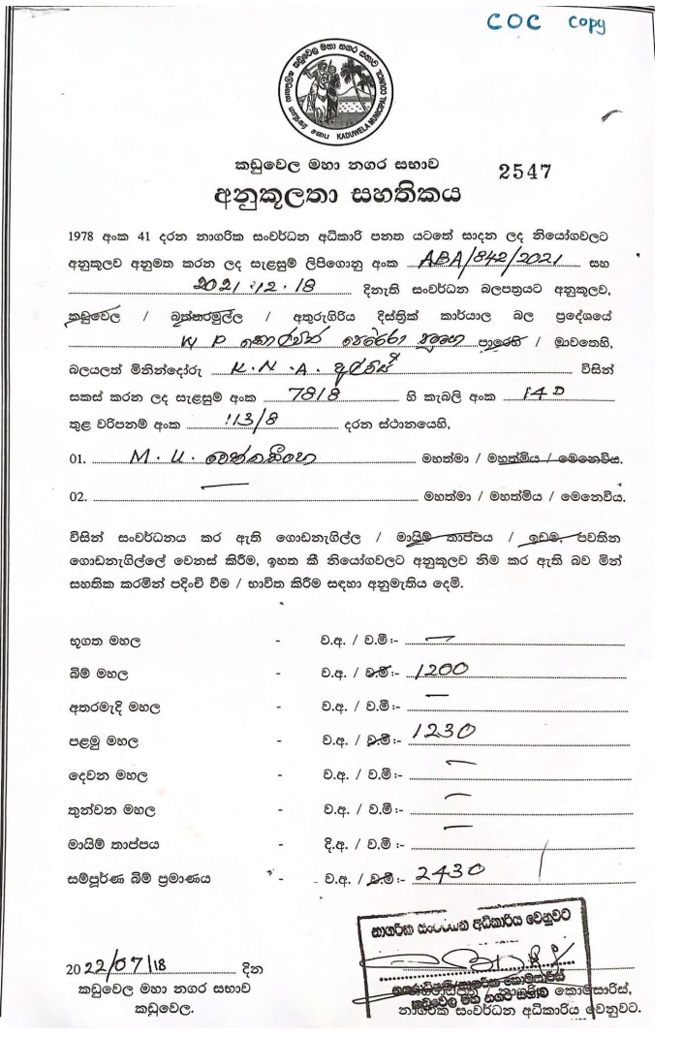
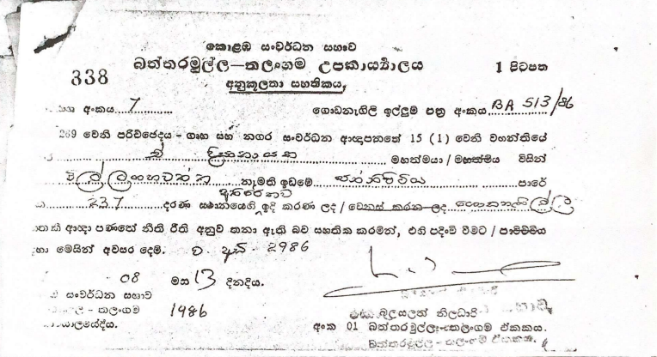
  Certificate of conformity
This certificate is issued in order to confirm that a particular building has been constructed in conformity with the approved survey plan. This certificate should be obtained from the Pradeshiya Sabha before taking up residence in the constructed building.
For this purpose,
An application form should be obtained from the office on payment of (Rs. 200.00= + VAT) and an additional sum will have to be paid according to the area of the building in square feet.
If the construction cannot be completed within one year, the period should be extended.
It the validity period of the approved plan has exceeded three years, the plan has to be resubmitted together with a fresh application form and a copy of the relevant approved plan.
The plan is forwarded to the planning committee after being recommended by the technical officer or the public health inspector.
The certificate of conformity is issued upon receiving the approval of the committee.

Slide 7
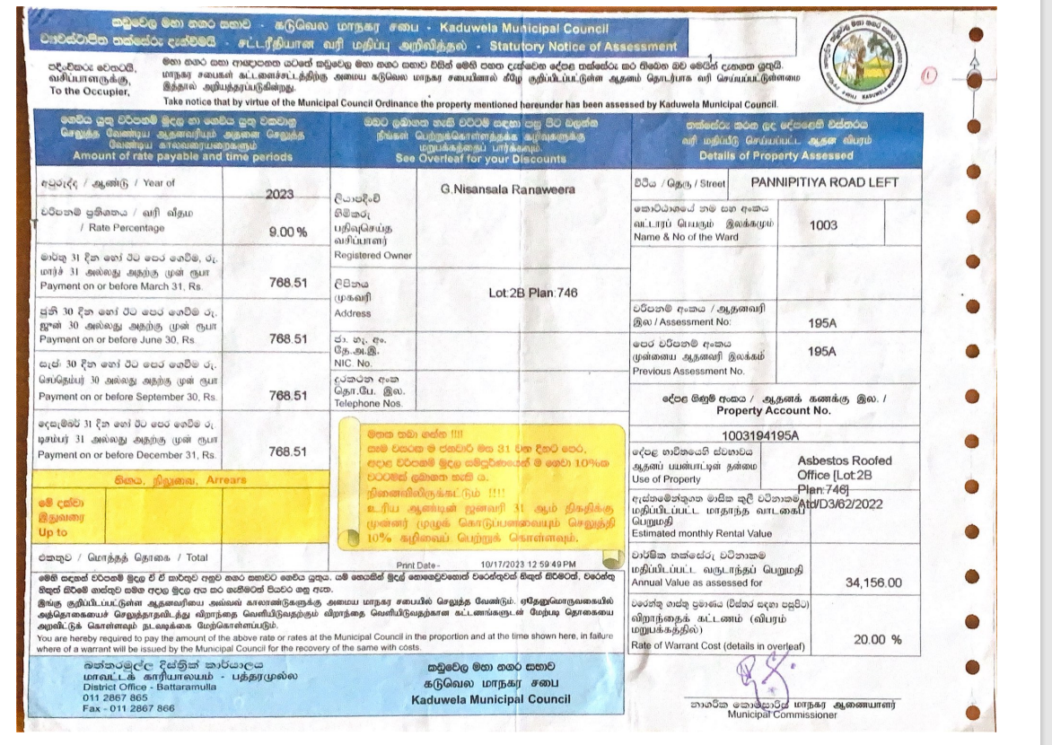
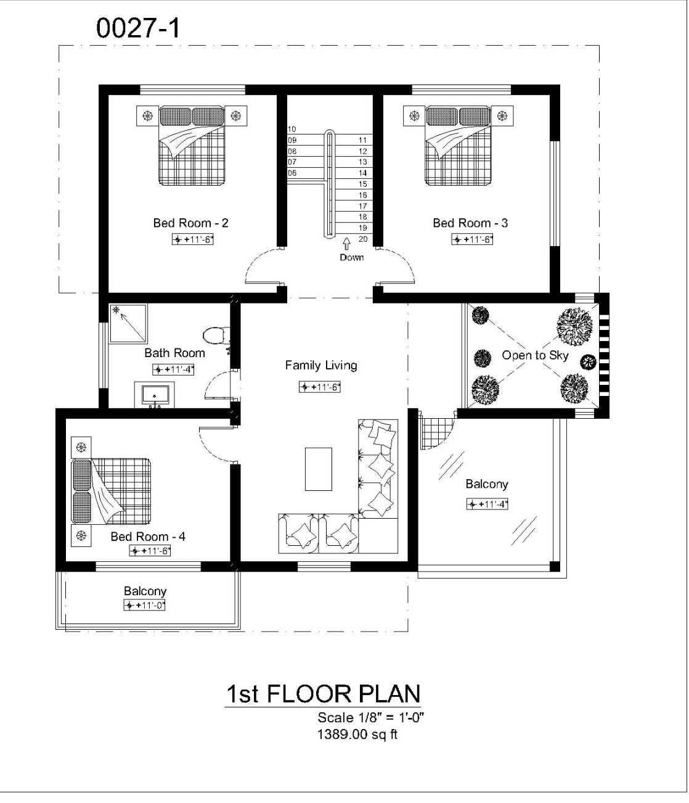
Approved building plans “if there is a building”
Last Payment of tax receipt

Slide 8
Notice of assessment for the current year
Your notice of assessment (NOA) is the statement issued that explains how your tax assessment is calculated. Your NOA will show the amount of:
tax you owe on your taxable income

Slide 9
Obtaining certificate of non-vesting
Ascertain whether any street line approved by the Council passes through the property.
Duties of a Notary where the property is situated in local limits of Municipal Council or Urban Council or Pradeshiya Sabha
Duties of a Notary where the property is situated in local limits of Municipal Council or Urban Council or Pradeshiya Sabha
must register the mortgage in the books kept by the local authority
purchaser inserted in the Assessment Register of the local body as the new owner of the property

Slide 10
THANK YOU!

